Slide 1

Internship Review
Internship Title – OCR Topsy Image Classification
Intern Name – Aditya Pandey
Duration – 3 months

Slide 2
Deliverables
A machine learning model which when given image of document classifies it into readable or not.
Classification Classes :-
Not Readable
Readable

Slide 3
Week #1 – Task Completed
For the first week's task, I collected data, preprocessed it, and developed three distinct machine learning models. Due to the unavailability of a suitable dataset containing medical documents or lab reports, I utilized the FUNSD dataset, which comprises random images of documents. The dataset initially consisted of clear document images, which were subsequently altered to be unreadable during the preprocessing phase to facilitate classification. This approach aimed to build a model capable of distinguishing between readable and unreadable document images.

Slide 4
Preprocessing
The unreadability of text can be attributed to three main factors: blur, rotation, and cropping of the text in the image. A conventional Convolutional Neural Network (CNN) model is not suitable for this application. Training such a model requires loading all images into the system's RAM, which necessitates scaling down the images to avoid memory overflow. However, scaling down non-blurred images can introduce blur, rendering them unreadable.
To address this issue, an alternative approach was employed. Instead of relying on the convolutional layers of a CNN for feature extraction, features (metadata) were extracted during the preprocessing phase for all three factors. This was achieved by loading images into RAM one at a time, thus preventing memory errors. This method allowed the extraction of essential metadata from each image without loss of information, ensuring that the images' readability attributes were preserved.

Slide 5
Preprocessing Continued
To detect blur, two methods were employed: Frequency Analysis using Discrete Fourier Transform (DFT) and the Variance of Laplacian. In Frequency Analysis, the Fast Fourier Transform (FFT) identifies high and low frequency magnitudes, with blurred images showing high magnitudes only in the low-frequency zone. The Variance of Laplacian method calculates the second derivative of pixel value changes, with clear images having high variance due to sharp edges.
For rotation detection, images are thresholded and morphologically dilated to connect words into single lines. The Hough Transform identifies these lines and their angles, and the median angle is used for heuristic rotation correction.
For crop detection, the image is corrected for rotation and dilated to find text bounding boxes. The margins of these boxes are then analyzed; improperly cropped images have shorter margins, indicating partial text cut-off.

Slide 6
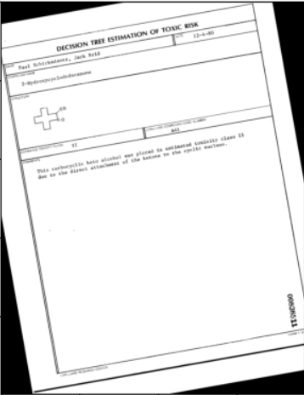
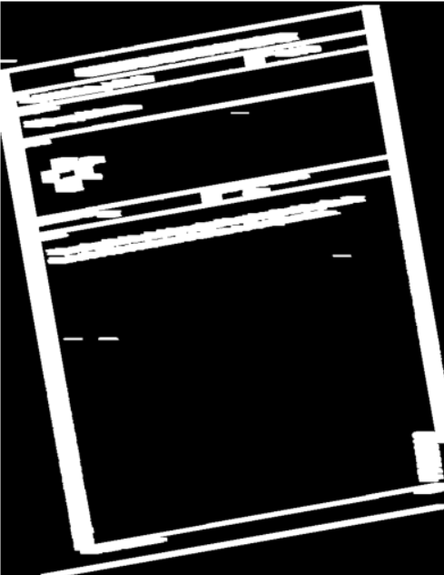
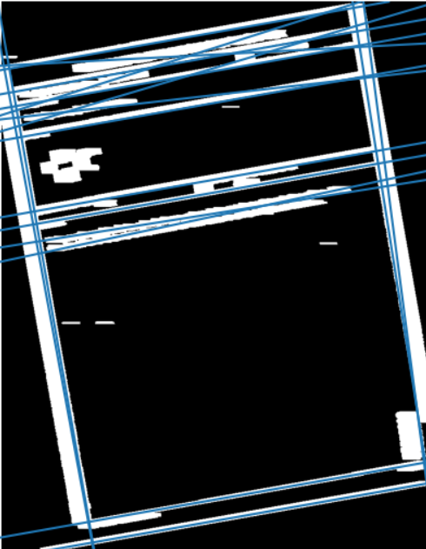
Preprocessing Continued
Original Image
Morphological Dilation
Lines detected in Hilbert Transform

Slide 7
Fitting Model
Three different models were fitted on the extracted features for classification: a simple Artificial Neural Network (ANN), Support Vector Machines (SVM), and a Decision Tree. All three models achieved 100% testing accuracy. The models were retrained from scratch multiple times, leading to the conclusion that the ANN exhibited some instability, occasionally yielding an accuracy of 96-98%. In contrast, the SVM and Decision Tree consistently maintained an accuracy of 100%.

